Slide 1
Limits
f(x) can become arbitrarily large
f(x) can approach a finite value
As x approaches a finite value
As x becomes arbitrarily large

Slide 2

Limits
Some limits do not exist
f(x) can become arbitrarily large
Worked example
f(x) can approach a finite value
Show that
$$\lim_{x→1}{2x}=2$$
As x approaches a finite value
As x becomes arbitrarily large

Slide 3

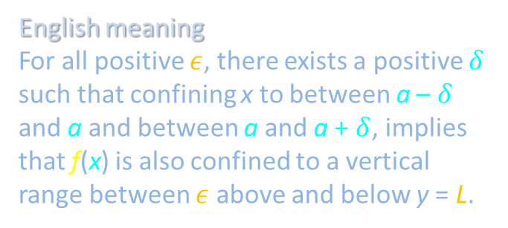
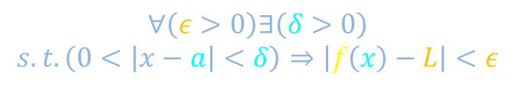
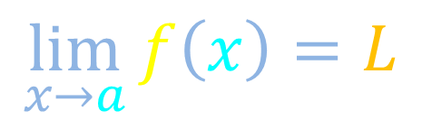
$ε−δ$ definition of limit of a function
Notation
y
$$\lim_{x→a}{f\left(x\right)}=L$$
Vernacular
As x becomes arbitrarily close to a, f(x) becomes arbitrarily close to L.
Symbolic meaning
$$∀\left(ε>0\right)∃\left(δ>0\right)$$
$$s.t.\left(0<\left|x−a\right|<δ\right)⇒\left|f\left(x\right)−L\right|<ε$$
English meaning
For all positive $ε$, there exists a positive $δ$ such that confining x to between a – $δ$ and a and between a and a + $δ$, implies that f(x) is also confined to a vertical range between $ε$ above and below y = L.
x

Slide 4




$ε−δ$ definition of limit of a function
Notation
y
$$\lim_{x→a}{f\left(x\right)}=L$$
L+$ε$
Vernacular
As x becomes arbitrarily close to a, f(x) becomes arbitrarily close to L.
Symbolic meaning
L
$$∀\left(ε>0\right)∃\left(δ>0\right)$$
$$s.t.\left(0<\left|x−a\right|<δ\right)⇒\left|f\left(x\right)−L\right|<ε$$
English meaning
For all positive $ε$, there exists a positive $δ$ such that confining x to between a – $δ$ and a and between a and a + $δ$, implies that f(x) is also confined to a vertical range between $ε$ above and below y = L.
L-$ε$
x
a-$δ$
a
a+$δ$

Slide 5




$ε−δ$ definition of limit of a function
Notation
y
$$\lim_{x→a}{f\left(x\right)}=L$$
Vernacular
As x becomes arbitrarily close to a, f(x) becomes arbitrarily close to L.
L+$ε$
Symbolic meaning
L
$$∀\left(ε>0\right)∃\left(δ>0\right)$$
$$s.t.\left(0<\left|x−a\right|<δ\right)⇒\left|f\left(x\right)−L\right|<ε$$
L-$ε$
English meaning
For all positive $ε$, there exists a positive $δ$ such that confining x to between a – $δ$ and a and between a and a + $δ$, implies that f(x) is also confined to a vertical range between $ε$ above and below y = L.
x
a-$δ$
a
a+$δ$

Slide 6










$ε−δ$ definition of limit of a function
Notation
y
$$\lim_{x→a}{f\left(x\right)}=L$$
Vernacular
As x becomes arbitrarily close to a, f(x) becomes arbitrarily close to L.
L+$ε$
$$ε$$
Symbolic meaning
L
$$ε$$
L-$ε$
$$∀\left(ε>0\right)∃\left(δ>0\right)$$
$$s.t.\left(0<\left|x−a\right|<δ\right)⇒\left|f\left(x\right)−L\right|<ε$$
$$ε$$
English meaning
For all positive $ε$, there exists a positive $δ$ such that confining x to between a – $δ$ and a and between a and a + $δ$, implies that f(x) is also confined to a vertical range between $ε$ above and below y = L.
$$δ$$
$$δ$$
$$δ$$
x
a-$δ$
a
a+$δ$

Slide 7

$ε−δ$ definition of limit of a function
Notation
y
$$\lim_{x→a}{f\left(x\right)}=L$$
Vernacular
As x becomes arbitrarily close to a, f(x) becomes arbitrarily close to L.
L+$ε$
Can L still be the limit of f(x) as x approaches a if, as illustrated, f(a) no longer equals L?
L
STOP
L-$ε$
English meaning
For all positive $ε$, there exists a positive $δ$ such that confining x to between a – $δ$ and a and between a and a + $δ$, implies that f(x) is also confined to a vertical range between $ε$ above and below y = L.
x
a-$δ$
a
a+$δ$

Slide 8
Limits
Some limits do not exist
f(x) can become arbitrarily large
Worked example
f(x) can approach a finite value
Show that
$$\lim_{x→1}{2x}=2$$
As x approaches a finite value
As x becomes arbitrarily large

Slide 9
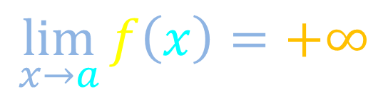
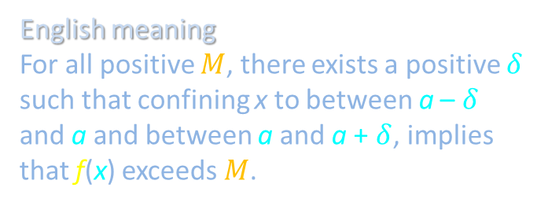
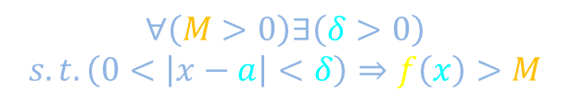
Definition of improper limit of a function
Notation
y
$$\lim_{x→a}{f\left(x\right)}=+∞$$
Vernacular
As x becomes arbitrarily close to a, f(x) becomes arbitrarily large.
Symbolic meaning
$$∀\left(M>0\right)∃\left(δ>0\right)$$
$$s.t.\left(0<\left|x−a\right|<δ\right)⇒f\left(x\right)>M$$
English meaning
For all positive $M$, there exists a positive $δ$ such that confining x to between a – $δ$ and a and between a and a + $δ$, implies that f(x) exceeds $M$.
x

Slide 10


Definition of improper limit of a function
Notation
y
$$\lim_{x→a}{f\left(x\right)}=+∞$$
Vernacular
As x becomes arbitrarily close to a, f(x) becomes arbitrarily large.
Symbolic meaning
$$∀\left(M>0\right)∃\left(δ>0\right)$$
$$s.t.\left(0<\left|x−a\right|<δ\right)⇒f\left(x\right)>M$$
M
English meaning
For all positive $M$, there exists a positive $δ$ such that confining x to between a – $δ$ and a and between a and a + $δ$, implies that f(x) exceeds $M$.
x
a-$δ$
a
a+$δ$

Slide 11


Definition of improper limit of a function
Notation
y
$$\lim_{x→a}{f\left(x\right)}=+∞$$
Vernacular
As x becomes arbitrarily close to a, f(x) becomes arbitrarily large.
Symbolic meaning
$$∀\left(M>0\right)∃\left(δ>0\right)$$
$$s.t.\left(0<\left|x−a\right|<δ\right)⇒f\left(x\right)>M$$
M
English meaning
For all positive $M$, there exists a positive $δ$ such that confining x to between a – $δ$ and a and between a and a + $δ$, implies that f(x) exceeds $M$.
x
a-$δ$
a
a+$δ$

Slide 12







Definition of improper limit of a function
Notation
y
$$\lim_{x→a}{f\left(x\right)}=+∞$$
Vernacular
As x becomes arbitrarily close to a, f(x) becomes arbitrarily large.
M
Symbolic meaning
$$∀\left(M>0\right)∃\left(δ>0\right)$$
$$s.t.\left(0<\left|x−a\right|<δ\right)⇒f\left(x\right)>M$$
$$M$$
$$M$$
$$M$$
English meaning
For all positive $M$, there exists a positive $δ$ such that confining x to between a – $δ$ and a and between a and a + $δ$, implies that f(x) exceeds $M$.
$$δ$$
$$δ$$
$$δ$$
x
a-$δ$
a
a+$δ$

Slide 13

Definition of improper limit of a function
Notation
y
$$\lim_{x→a}{f\left(x\right)}=+∞$$
Vernacular
As x becomes arbitrarily close to a, f(x) becomes arbitrarily large.
M
Symbolic meaning
$$∀\left(M>0\right)∃\left(δ>0\right)$$
$$s.t.\left(0<\left|x−a\right|<δ\right)⇒f\left(x\right)>M$$
English meaning
For all positive $M$, there exists a positive $δ$ such that confining x to between a – $δ$ and a and between a and a + $δ$, implies that f(x) exceeds $M$.
Write down the analogous definition for $\lim_{x→a}{f\left(x\right)=−∞}$
STOP
x
a-$δ$
a
a+$δ$

Slide 14
Limits
Some limits do not exist
f(x) can become arbitrarily large
Worked example
f(x) can approach a finite value
Show that
$$\lim_{x→1}{2x}=2$$
As x approaches a finite value
As x becomes arbitrarily large

Slide 15

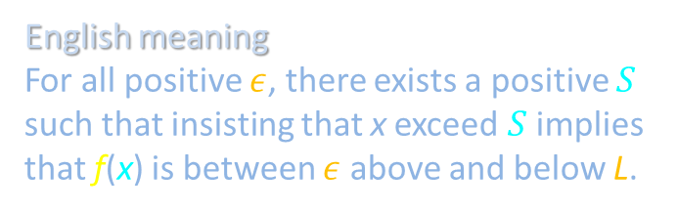
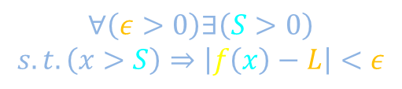
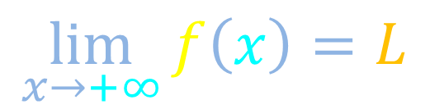
Definition of limit of a function as $x→+∞$
Notation
y
$$\lim_{x→+∞}{f\left(x\right)}=L$$
Vernacular
As x becomes arbitrarily large, f(x) becomes arbitrarily close to L.
Symbolic meaning
$$∀\left(ε>0\right)∃\left(S>0\right)$$
$$s.t.\left(x>S\right)⇒\left|f\left(x\right)−L\right|<ε$$
English meaning
For all positive $ε$, there exists a positive $S$ such that insisting that x exceed $S$ implies that f(x) is between $ε$ above and below L.
x

Slide 16


Definition of limit of a function as $x→+∞$
Notation
y
$$\lim_{x→+∞}{f\left(x\right)}=L$$
L+$ε$
Vernacular
As x becomes arbitrarily large, f(x) becomes arbitrarily close to L.
L
L-$ε$
Symbolic meaning
$$∀\left(ε>0\right)∃\left(S>0\right)$$
$$s.t.\left(x>S\right)⇒\left|f\left(x\right)−L\right|<ε$$
English meaning
For all positive $ε$, there exists a positive $S$ such that insisting that x exceed $S$ implies that f(x) is between $ε$ above and below L.
x
S

Slide 17


Definition of limit of a function as $x→+∞$
Notation
y
$$\lim_{x→+∞}{f\left(x\right)}=L$$
L+$ε$
Vernacular
As x becomes arbitrarily large, f(x) becomes arbitrarily close to L.
L
L-$ε$
Symbolic meaning
$$∀\left(ε>0\right)∃\left(S>0\right)$$
$$s.t.\left(x>S\right)⇒\left|f\left(x\right)−L\right|<ε$$
English meaning
For all positive $ε$, there exists a positive $S$ such that insisting that x exceed $S$ implies that f(x) is between $ε$ above and below L.
x
S

Slide 18








Definition of limit of a function as $x→+∞$
Notation
y
$$\lim_{x→+∞}{f\left(x\right)}=L$$
Vernacular
As x becomes arbitrarily large, f(x) becomes arbitrarily close to L.
L+$ε$
L
$$ε$$
L-$ε$
$$ε$$
$$ε$$
Symbolic meaning
$$∀\left(ε>0\right)∃\left(S>0\right)$$
$$s.t.\left(x>S\right)⇒\left|f\left(x\right)−L\right|<ε$$
English meaning
For all positive $ε$, there exists a positive $S$ such that insisting that x exceed $S$ implies that f(x) is between $ε$ above and below L.
$$S$$
$$S$$
$$S$$
x
S

Slide 19
Limits
Some limits do not exist
f(x) can become arbitrarily large
Worked example
f(x) can approach a finite value
Show that
$$\lim_{x→1}{2x}=2$$
As x approaches a finite value
As x becomes arbitrarily large

Slide 20
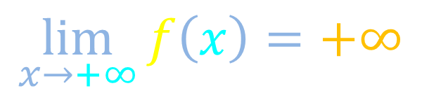
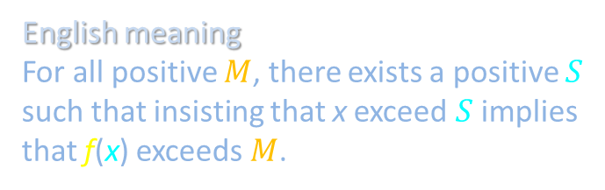
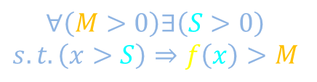
Improper limits at infinity
Notation
y
$$\lim_{x→+∞}{f\left(x\right)}=+∞$$
Vernacular
As x becomes arbitrarily large, f(x) becomes arbitrarily large.
Symbolic meaning
$$∀\left(M>0\right)∃\left(S>0\right)$$
$$s.t.\left(x>S\right)⇒f\left(x\right)>M$$
English meaning
For all positive $M$, there exists a positive $S$ such that insisting that x exceed $S$ implies that f(x) exceeds $M$.
x

Slide 21
Improper limits at infinity
Notation
y
$$\lim_{x→+∞}{f\left(x\right)}=+∞$$
Vernacular
As x becomes arbitrarily large, f(x) becomes arbitrarily large.
M
Symbolic meaning
$$∀\left(M>0\right)∃\left(S>0\right)$$
$$s.t.\left(x>S\right)⇒f\left(x\right)>M$$
English meaning
For all positive $M$, there exists a positive $S$ such that insisting that x exceed $S$ implies that f(x) exceeds $M$.
x
S

Slide 22
Improper limits at infinity
Notation
y
$$\lim_{x→+∞}{f\left(x\right)}=+∞$$
Vernacular
As x becomes arbitrarily large, f(x) becomes arbitrarily large.
M
Symbolic meaning
$$∀\left(M>0\right)∃\left(S>0\right)$$
$$s.t.\left(x>S\right)⇒f\left(x\right)>M$$
English meaning
For all positive $M$, there exists a positive $S$ such that insisting that x exceed $S$ implies that f(x) exceeds $M$.
x
S

Slide 23






Improper limits at infinity
Notation
y
$$\lim_{x→+∞}{f\left(x\right)}=+∞$$
M
Vernacular
As x becomes arbitrarily large, f(x) becomes arbitrarily large.
$$M$$
$$M$$
Symbolic meaning
$$M$$
$$∀\left(M>0\right)∃\left(S>0\right)$$
$$s.t.\left(x>S\right)⇒f\left(x\right)>M$$
English meaning
For all positive $M$, there exists a positive $S$ such that insisting that x exceed $S$ implies that f(x) exceeds $M$.
$$S$$
$$S$$
$$S$$
x
S

Slide 24
Limits
Some limits do not exist
f(x) can become arbitrarily large
Worked example
f(x) can approach a finite value
Show that
$$\lim_{x→1}{2x}=2$$
As x approaches a finite value
As x becomes arbitrarily large

Slide 25








Sometimes a limit does not exist (D.N.E.)
Example: Limit of a function
Example: Limit as x becomes arbitrarily large
$$\lim_{x→a}{f\left(x\right)}=D.N.E.$$
$$\lim_{x→+∞}{f\left(x\right)}=D.N.E.$$
y
y
L+$ε$
L
L-$ε$
L+$ε$
L
L-$ε$
x
x
a-$δ$
a
a+$δ$
S

Slide 26
Limits
Some limits do not exist
f(x) can become arbitrarily large
Worked example
f(x) can approach a finite value
Show that
$$\lim_{x→1}{2x}=2$$
As x approaches a finite value
As x becomes arbitrarily large

Slide 27






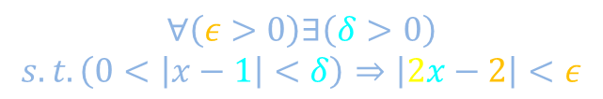
Example: $\lim_{x→1}{2x}=2$
$$\lim_{x→1}{2x}=2$$
Want to show
Show that
$$∀\left(ε>0\right)∃\left(δ>0\right)$$
$$s.t.\left(0<\left|x−1\right|<δ\right)⇒\left|2x−2\right|<ε$$
y
2+$ε$
2
2-$ε$
x
1-$δ$
1
1+$δ$

Slide 28

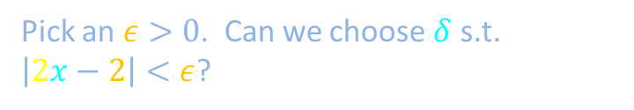


















Example: $\lim_{x→1}{2x}=2$
$$\lim_{x→1}{2x}=2$$
Want to show
Show that
$$∀\left(ε>0\right)∃\left(δ>0\right)$$
$$s.t.\left(0<\left|x−1\right|<δ\right)⇒\left|2x−2\right|<ε$$
Pick an arbitrary $δ>0$
y
$$y_{MAX}=2\left(1+δ\right)$$
$$y_{MIN}=2\left(1−δ\right)$$
$$y_{MAX}=2+2δ$$
$$y_{MIN}=2−2δ$$
Pick an $ε>0$. Can we choose $δ$ s.t. $\left|2x−2\right|<ε$?
2+$ε$
y_{MAX}
$$\left|y_{MAX}−2\right|<ε$$
$$\left|y_{MIN}−2\right|<ε$$
2
$$\left|\left(2+2δ\right)−2\right|<ε$$
$$\left|\left(2−2δ\right)−2\right|<ε$$
y_{MIN}
2-$ε$
$$\left|2δ\right|<ε$$
$$\left|−2δ\right|<ε$$
$$2δ<ε$$
$$δ<\frac{ε}{2}$$
Works for any $ε$
$⇒ \lim_{x→1}{2x}=2$
x
1-$δ$
1
1+$δ$

Slide 29
Limits
Some limits do not exist
f(x) can become arbitrarily large
Worked example
f(x) can approach a finite value
Show that
$$\lim_{x→1}{2x}=2$$
As x approaches a finite value
As x becomes arbitrarily large

Slide 30








Definition of improper limit of a function
Notation
y
$$\lim_{x→a}{f\left(x\right)}=+∞$$
M
Vernacular
As x becomes arbitrarily close to a, f(x) becomes arbitrarily large.
Symbolic meaning
$$M$$
$$M$$
$$∀\left(M>0\right)∃\left(δ>0\right)$$
$$s.t.\left(0<\left|x−a\right|<δ\right)⇒f\left(x\right)>M$$
$$M$$
English meaning
For all positive $M$, there exists a positive $δ$ such that confining x to between a – $δ$ and a and between a and a + $δ$, implies that f(x) exceeds $M$.
$$δ$$
$$δ$$
$$δ$$
x
a-$δ$
a
a+$δ$

